Slide 1






Checking and securing finding a fraction of a given amount
Task A: Using a bar model to find fractions of amounts
Use the bar models to answer the following:
of 40 = 8
of 40 = 24
of 40 = 15
of 40 = 35
of 40 = 12
of 40 = 28

Slide 2
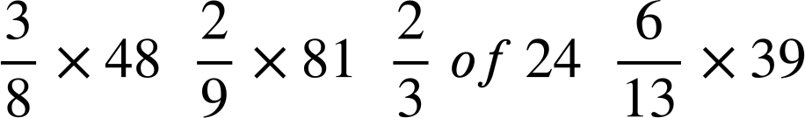

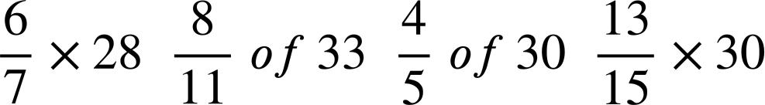

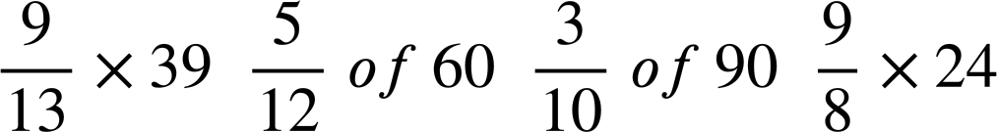

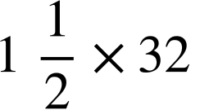

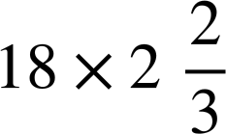



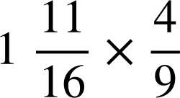

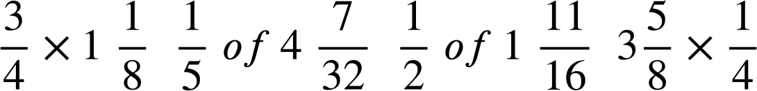





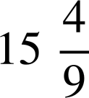
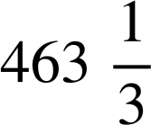
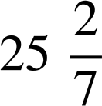
Checking and securing finding a fraction of a given amount
TASK B: Fractions of amounts as multiplication
Find the odd one out in each row. It has a different answer to the others.
Arrange the letters of these into a word.
18
A
18
I
16
E
18
U
24
S
24
N
24
Y
26
R
27
M
25
P
27
W
27
C
48
D
48
E
49
O
48
G
T
R
F
H
P
T
L
K
The word is PROPER.
Task C: Fractions greater than 1
1) Calculate the following:
a) of 180 = 324
b) of 48 = 84
c) of 136 = 799
d) of 30 =
e) of 21 = 531
Mathematics in Education and Industry
v2.2

